Slide 1
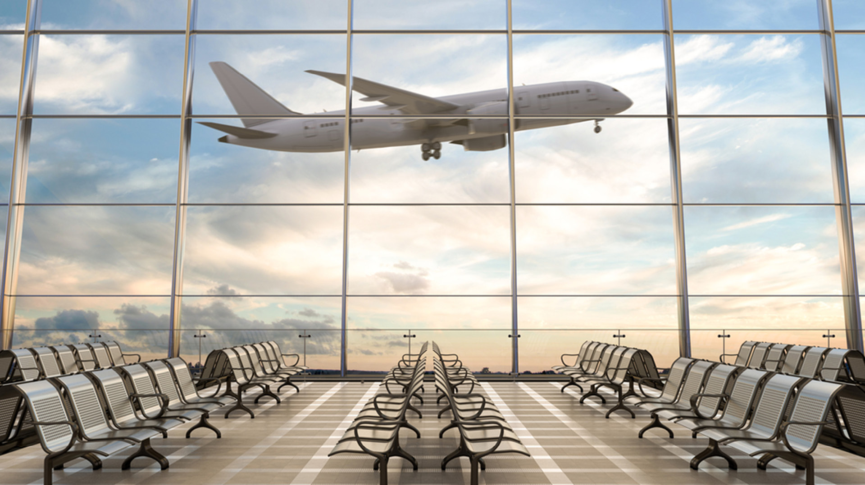
𝒯𝒽𝑒 𝒜𝒾𝓇𝒫𝑜𝓇𝓉
Ренета Топалкса

Slide 2
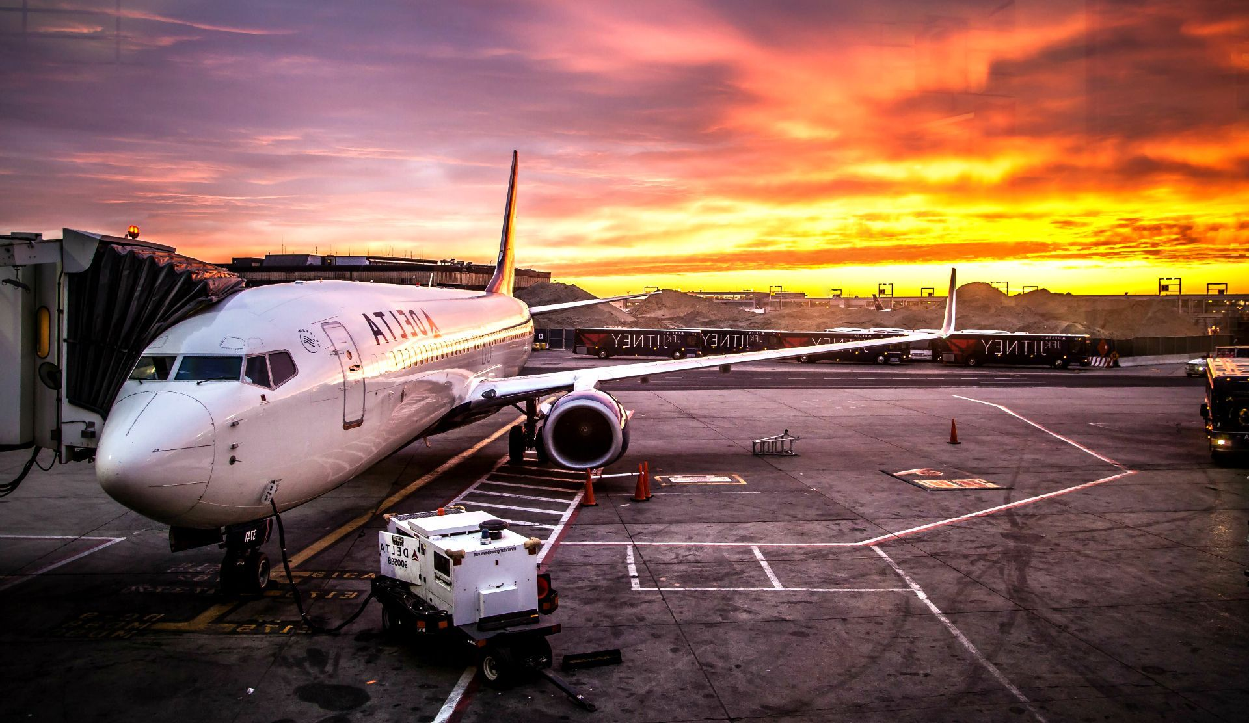
Implementation of the tasks
Ренета Топалска – Back-End and Front-End developer, Presentation, Designer, Documentation,

Slide 3
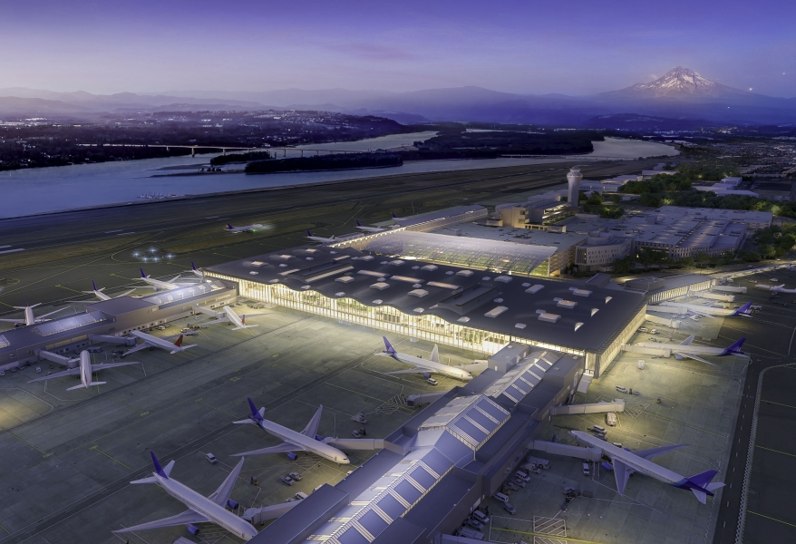
Technology used
Power Point
Word
Visual Studio Code
Visual Studio
Microsoft SQL Server
Github

Slide 4
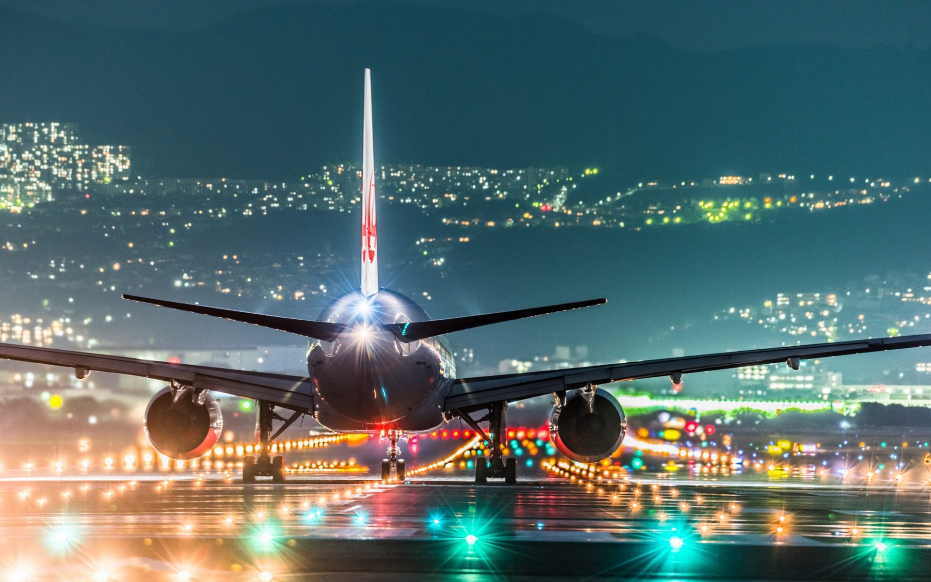

Future plans
Implement more countries
Implement more options
Implement flights
Add more information about the flights

Slide 5

Now I will show you the program and then the website!

Slide 6

Thank you for your attention!

